Slide 1
SWE30003 Software Architectures and Design
Lecture 1 Issues in Software Design

Slide 2
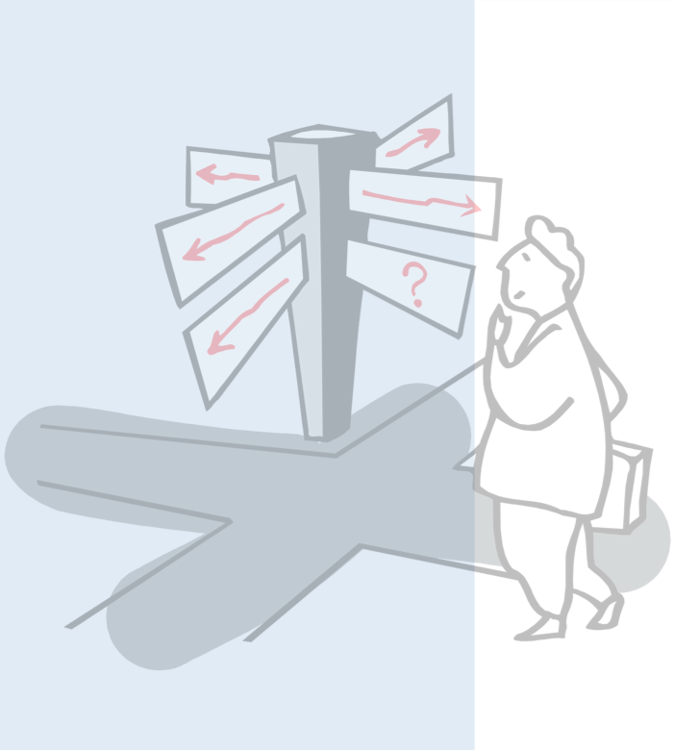
Outline
Unit of Study Overview
What Drives Software Development?
From Business Goals to Requirements
Functional vs. Non-functional
Verification & Validation
What is Design, what drives Design?

Slide 3
Software Development Activities
Requirements Elicitation | Establish customer’s needs
Requirements Analysis | Model and specify the requirements (“what”)
Design | Model and specify a solution (“how”)
Implementation | Construct a solution in software
Testing | Verify the solution against the requirements
Maintenance | Repair defects and adapt the solution to new requirements
NB: these are ongoing activities, not sequential phases!

Slide 4
Focus of Unit of Study
Requirements Elicitation | Establish customer’s needs
Requirements Analysis | Model and specify the requirements (“what”)
Design | Model and specify a solution (“how”)
Implementation | Construct a solution in software
Testing | Verify the solution against the requirements
Maintenance | Repair defects and adapt the solution to new requirements
Notes:
Note: the main focus will be on R&A and D, but Assignment 3 will do a “proof of concept” implementation of a design…

Slide 5
What we will be talking about…
Validation & Verification
Decomposition
Notes:
Explain here that the student should start creating a mental model for themselves – the links and relevance will become clear(er) over the next few weeks…

Slide 6
Outline
Unit of Study Overview
What Drives Software Development?
From Business Goals to Requirements
Functional vs. Non-functional
Verification & Validation
What is Design, what drives Design?

Slide 7
Why do we build Software Systems?
To keep/retain customers
To increase customer base
To improve customer relationships
To improve productivity/efficiency (within organization/team)
Technology used no longer supported/outdated
Changes in environment (legal, social)
To achieve some “Business” Goals!
Notes:
There is always a “business” context in which software is developed.
If we talk about open source development, the business context may not always be that evident…

Slide 8
Categories of Business Goals
Business goals fall into five broad categories:
Reduce cost of ownership: development, maintenance, deployment, operation.
Improve the quality of the system(s) compared with its predecessors with respect to performance, modifiability, security, reliability etc.
Improve the capabilities/functionality offered by the system compared to its predecessors.
Improve organization’s market position.
Improve external confidence in either the organization or the system.
A particular system has generally more than one goal!
To address some “pain points”
Notes:
Source: Swinburne Presentation of Len Bass
Need to talk quite a bit about this…
Recapitulating pain points from SDP…

Slide 9
Views of Stakeholders
Many systems involve a variety of different stakeholders:
Customers
Developers
Managers
Users
All of them have different views and priorities
May even lead to conflicting goals!
Development approaches must be able to cater for different views and priorities!
Notes:
Note: customers may not necessarily be the users of a system.
If customers think they know what the user wants (but are wrong), problems will inevitably occur.

Slide 10
Business Goals (cont.)
Priority of goals need to be specified:
Some goals are “nice to have”, others “need to have”, some “absolutely critical”
Developers sometimes have to “push back” or make trade offs. Knowing priority gives insights.
Source of goals need be specified:
Some goals are inherent to the system being developed
Some goals are a result of market analysis
Some goals are arbitrary - could cause problems!
Notes:
Talk about what arbitrary goals are… and where they come from…

Slide 11
Outline
Unit of Study Overview
What Drives Software Development?
From Business Goals to Requirements
Functional vs. Non-functional
Verification & Validation
What is Design, what drives Design?

Slide 12
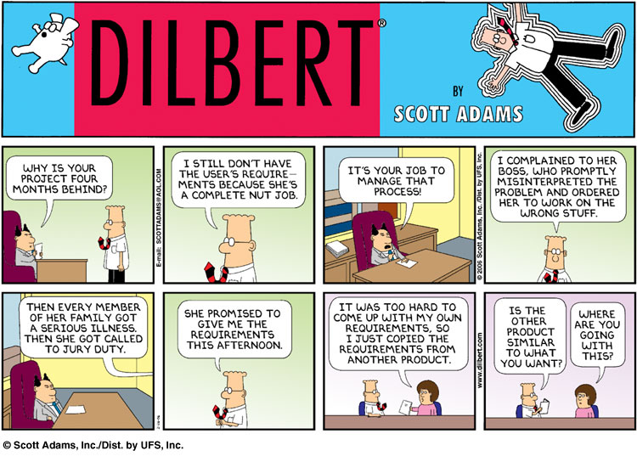
http://en.wikipedia.org/wiki/Fair_use

Slide 13
Outline
Unit of Study Overview
What Drives Software Development?
From Business Goals to Requirements
Functional vs. Non-functional
Verification & Validation
What is Design, what drives Design?

Slide 14
Functional and Non-functional Requirements
Functional requirements describe system services or functions
Compute sales tax on a purchase
Update the database on the server ...
In essence, anything that can be directly expressed in code…
Non-functional requirements (also known as quality requirements) are constraints on the services and/or the development process
“Reducing cost of deployment” cannot be directly expressed in code…
Domain requirements stem from the application domain of a system
may be functional or non-functional
Notes:
Note: we may also talk about financial and time issues here…
Another aspect worth mentioning is ‘engagement’ of users – hard to define and even harder to measure…

Slide 15
Non-functional Requirements
Product requirements: | specify that the delivered product must behave in a particular way e.g. execution speed, reliability, etc.
Organizational requirements: | are a consequence of organizational policies and procedures e.g. process standards used, implementation requirements, etc.
External requirements: | arise from factors which are external to the system and its development process e.g. interoperability requirements, legislative requirements, etc.

Slide 16
Examples of Non-functional Requirements
Product requirement | It shall be possible for all communication between the console and the user to be expressed in the standard ASCII character set.
Organisational requirement | The system development process and deliverable documents shall conform to the process and deliverables defined in XYZCo-SP-STAN-95.
External requirement | The system shall provide facilities that allow any user to check if personal data is maintained on the system. A process must be defined and supported in the software that will allow users to inspect personal data and to correct any errors in that data.
We will talk more about non-functional requirements in Week 3

Slide 17
Outline
Unit of Study Overview
What Drives Software Development?
From Business Goals to Requirements
Functional vs. Non-functional
Verification & Validation
What is Design, what drives Design?

Slide 18
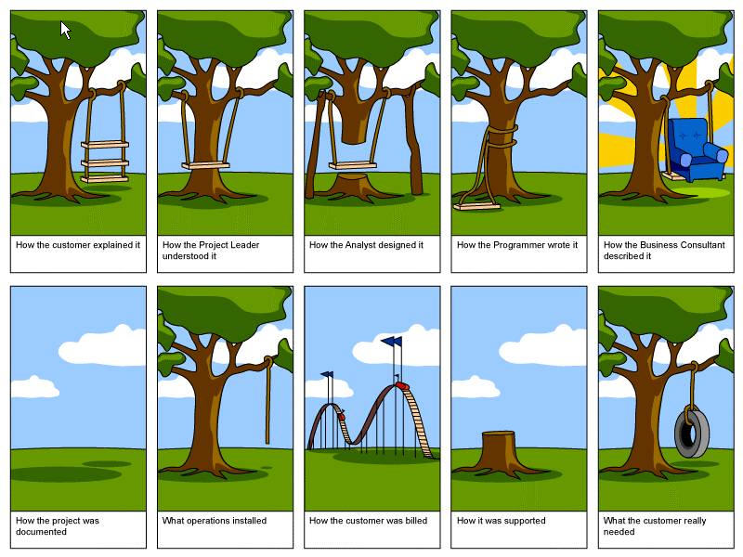
Impedance Mismatches
Notes:
There is a LOT of truth to this cartoon…

Slide 19
Verification and Validation
Verification:
Are we building the product right?
i.e., does it conform to the specification(s)?
Validation:
Are we building the right product?
i.e., does it meet stakeholders’ expectations?
Notes:
— Boehm (1979)

Slide 20
Requirements Verifiability
Requirements must be written so that they can be validated and objectively verified.
Imprecise:
“The system should be easy to use by experienced controllers and should be organized in such a way that user errors are minimized.”
Terms like “easy to use” and “errors shall be minimized” are useless as specifications as they are too vague.
Verifiable:
“Experienced controllers should be able to use all the system functions after a total of two hours training. After this training, the average number of errors made by experienced users should not exceed two per day.”
You will hear a lot about requirements verifiability throughout the semester!
Notes:
It is rarely easy to write down quality requirements in a very precise, hence verifiable way…

Slide 21
Requirements Verifiability – More Examples
❌ IMPRECISE (Not Verifiable)
✓ VERIFIABLE (Measurable)
Performance
"The system should respond quickly to user queries."
"The system shall respond to any user query within 2 seconds under normal load (≤500 concurrent users)."
Reliability
"The software should be reliable and rarely crash."
"The system shall have an availability of at least 99.5% per month, with no single outage exceeding 4 hours."
Security
"User data must be kept safe and secure."
"All user passwords shall be stored using bcrypt with cost factor ≥12. Failed logins exceeding 5 in 10 mins shall lock the account."
Usability
"New users should find the interface intuitive."
"A new user with no training shall complete checkout in under 3 minutes, with task completion rate ≥90% in usability testing."
💡 Rule of thumb: If you cannot write a test to check it, the requirement is NOT verifiable!

Slide 22
Outline
Unit of Study Overview
What Drives Software Development?
From Business Goals to Requirements
Functional vs. Non-functional
Verification & Validation
What is Design, what drives Design?

Slide 23
Software Design – a “Definition”
“Software design is the activity of drawing UML class diagrams once a software system has been coded in order to satisfy the requirements of unit conveners.”
Would you trust the software of an air-traffic control system that was implemented without prior structural analysis etc.?

Slide 24
Design vs. Design
“Design is the creative process of transforming the problem into a solution. The description of the solution is also called the design.”
— Shari Lawrence Pfleeger, 1998
“The design of a system determines a set of components and inter-component interfaces that satisfy a specified set of requirements.”
— DeMarco, 1982
Activity
Artefact
Notes:
Design as an activity (process) vs. design as an end-result of this activity (artefact)
One should *DEFINITELY* add here that any design process should facilitate the development, not hinder it. “Facilitating” may not always be that bluntly obvious!!

Slide 25
Design Process
Notes:
Again, there exist a multitude of notations to communicate design…

Slide 26
The Process of Decomposition
Decomposition is a process that helps to manage the complexity of a software system
Starting with a high-level view of the system.
Creating the low-level details of the features of the system in turn.
Stop when we are satisfied with the level of detail.
Also known as Divide-and-Conquer.
Notes:
One of the most fundamental approaches to software development…

Slide 27
Decomposition in Practice – Online Shopping System
Level 1
System
Online Shopping System
Level 2
Subsystems
User Management
Product Catalogue
Order Processing
Payment Gateway
Level 3
Modules
Register / Login
Browse Products
Cart Management
Card Payment
Profile Update
Search & Filter
Checkout Flow
PayPal / Wallet
Password Reset
Product Reviews
Order Tracking
Refund Handler
Each level adds detail — stop decomposing when modules are simple enough to design/code directly

Slide 28
Models
A model is a simplification of reality.
Models are created for better understanding of the problem, the domain, or the system to build.
A model can capture and represent,
Structure (static model)
Behavior (dynamic model)
Examples:
Architectural blue-print of a house
Hand-drawn screen (“wire-frame”)
Class diagram
Notes:
A model is an abstraction of reality through which we want to reduce complexity. By approaching reality from a diversity of perspectives we can create a number of models that give us a better handle on the complexity of the problem. Every model gives us a semantic fixture on a part of the problem. Compare it to an architect making models before actually building the house he was commissioned to build. After a few rough sketches, a number of models are built that will give a better understanding of the lay out of the house and the use of all the different rooms. In the end models will be made that will show more practical details like, for instance, light fixtures, central heating and plumbing.

Slide 29
Models in Different Contexts
Context
Model
Type
What It Captures
Static vs Dynamic – Side by Side
🏗️ Architecture
Blueprint
Static
Floor plan: rooms, walls & dimensions
📐 Static Model
▶ Dynamic Model
Captures STRUCTURE
Captures BEHAVIOUR
«class» User
Idle 💤
[ Insert Card ]
🚗 Engineering
Scale Prototype
Static
1:10 clay model of a new car body
«class» Order
Authenticate 🔐
[ PIN Verified ]
«class» Product
Withdraw 💵
[ Amount OK ]
☁️ Software
Class Diagram
Static
Classes: User, Order, Product + links
e.g. UML Class Diagram
Print Receipt 🧾
e.g. ATM State Machine Diagram
🔄 Software
Sequence Diagram
Dynamic
User logs in → server validates → token issued
🌐 Networking
Topology Diagram
Static
Nodes: Router, Switch, Server, Clients
💳 Banking App
State Machine
Dynamic
ATM: Idle → Auth → Withdraw → Done
💡 All models simplify reality — choose the model type that best answers your design question

Slide 30
Q: What has a bigger impact on the design structure of a software system: functional requirements or quality requirements?
A: Quality requirements determine most structural design decisions, not functional requirements!
Notes:
I will need to give some “evidence” here why this is the case…
- Scability and distribution of “single-user” systems
- Increasing reliability from, say 95% to 99%, then to 99.9%

Slide 31
Quality-Driven Design
Quality requirements are those that drive the structural design of the software system.
Leads to several questions:
How are quality requirements specified?
How are quality requirements validated?
This is also important for functional requirements!
How are quality requirements achieved?
How can understanding of the impact of quality attributes be used during the design process?
We will attempt to answer these questions over the next few weeks.
Notes:
Again, we will attempt to answer these questions over the next few weeks!

Slide 32
Why Quality Requirements Matter
Quality requirements determine WHAT we build for, functional requirements determine WHAT we build.
Quality Requirement | Without It — What Goes Wrong | With It — What You Gain
Performance (e.g. respond < 2s) | Page loads slowly → users abandon the site | Users stay engaged; business retains customers
Security (e.g. encrypt passwords) | Data breach exposes user passwords | User data is protected; legal compliance met
Reliability (e.g. 99.9% uptime) | System crashes during peak hours → lost revenue | Consistent service; trust & SLA compliance
Scalability (e.g. handle 10× load) | System collapses under high traffic (e.g. Black Friday) | Architecture grows with demand; no rewrites needed
Maintainability (e.g. modular code) | Changing one feature breaks unrelated parts | New features ship faster; bugs are isolated quickly

Slide 33
Quality Requirements in Practice — Real-World Examples
Each example shows how ONE quality requirement drives architecture and design decisions
Online Banking App
E-Commerce Platform (eBay)
Hospital Patient Monitor
QUALITY REQUIREMENT
QUALITY REQUIREMENT
QUALITY REQUIREMENT
Security: All data encrypted; 2FA required
Scalability: Handle 10x traffic spikes on peak days
Reliability: 99.99% uptime; no single point of failure
DESIGN DECISION
DESIGN DECISION
DESIGN DECISION
Separate auth service; HTTPS; salted password hashes
Microservices + load balancer + CDN + auto-scaling
Redundant servers; failover clustering; offline-capable cache
OUTCOME
OUTCOME
OUTCOME
Breaches blocked; PCI-DSS compliance met
Black Friday handled; no downtime; scales on demand
Critical alerts never missed; patients safe during outages
Key Takeaway: Ignoring quality requirements early forces expensive redesigns later — get them right from the start!

Slide 34
Forces in Software Projects
Time
Scope
Quality
Cost
Notes:
This slide needs A LOT of explanation - but is taken directly form SPPM!

Slide 35
Question to Answer Week 1
In your own words, characterize the difference between verification and validation and discuss where in the software development lifecycle (SDLC) verification and validation activities should be conducted, respectively.

Slide 36
Catch-up Reading Lecture 1
Len Bass, Paul Clements, Rick Kazman, Software Architecture in Practice (2nd Edition), Addison-Wesley, 2003, Chapter 1 (available electronically through the Swinburne Library)

Slide 37
Required Pre-Reading for Lecture 2
Soren Lauesen, Task Descriptions as Functional Requirements, IEEE Software, March 2003. (on Canvas, under week 2)

